Slide 1
Super resolution implementation on FPGA
Diksha Moolchandani Mentors: Prof. Kolin Paul, Prof. Anshul Kumar 9 Dec, 2015

Slide 2
for i = 1 : conv1_filters
conv1_data(:,:,i) = imfilter(im_b, weights_conv1(:,:,i), 'same', 'replicate');
conv1_data(:,:,i) = max(conv1_data(:,:,i) + biases_conv1(i), 0);
end
STAGE 1
for i = 1 : conv2_filters
for j = 1 : conv1_filters
conv2_data(:,:,i) = conv2_data(:,:,i) + weights_conv2(j,:,i) * conv1_data(:,:,j);
end
conv2_data(:,:,i) = max(conv2_data(:,:,i) + biases_conv2(i), 0);
end
STAGE 2
for i = 1 : conv2_filters
conv3_subfilter = reshape(weights_conv3(i,:), conv3_patchsize, conv3_patchsize);
conv3_data(:,:) = conv3_data(:,:) + imfilter(conv2_data(:,:,i), conv3_subfilter, 'same', 'replicate');
end
STAGE 3

Slide 3
Synchronization scheme
Each stage or sub-stage in the pipeline consistently has the following control signals
reset : in
clk : in
sync_minor_in : in
start_in : in
sync_minor_out : out
start_out : out
Specifications of these signals are given in the following slides
data_in
any_stage
data_out
sync_minor_in
sync_minor_out
start_in
start_out
reset
clk

Slide 4
Signals start_in, start_out
These signals have one pulse for each image frame, coinciding with the first sync_minor pulse of the frame.
The ON duration of these pulses coincides with one clk period, indicating start of the ‘frame’.
start_in (start_out) = 1 indicates availability of the first value of data_in (data_out) for the current frame.
start_out may be delayed with respect to start_in by an integral number of minor cycles plus an integral number of clk periods. Each of these two numbers may be zero or more .

Slide 5
TOP Level Super_Resolution block diagram
A
stage1
B
stage2
C
stage3
D
sync1
sync2
sync3
sync4
start_A
start_B
start_C
start_D
139.091MHz
139.091MHz
192.333MHz
reset
clk

Slide 6
Stage1 block diagram
PE
PE
A
toep_top
AT
PE
Btemp
PISO
B
sync1
sync_T1
sync_T2
sync2
start_A
start_T1
start_T2
start_B
302.778 MHz
214.954 MHz
376.752 MHz
reset
clk

Slide 7
Stage2 block diagram
B1
PE
C
sync2
sync3
start_B
start_C
214.954 MHz
reset
clk

Slide 8
Stage3 block diagram
C
toep_top
CT
PE
Ctemp
pipe_add
D
sync3
sync_T1
sync_T2
sync4
start_C
start_T1
start_T2
start_D
302.778 MHz
214.954 MHz
320.021 MHz
reset
clk

Slide 9
DDR3 INTERFACE

Slide 10
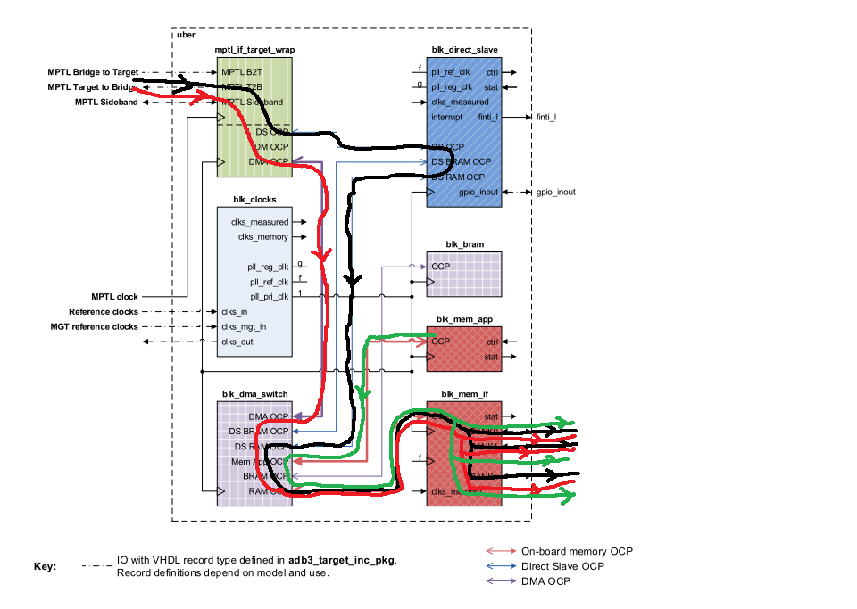
Data flow path from host to DDR3 SDRAM

Slide 11
UBER Design
In the Uber design, there are two things that can access the DDR3 SDRAM on the card:
The host, via the MPTL interface. The host can access any of the 4 banks by using the appropriate OCP address.
The RAM “blk_mem_app", since it is multiplexed via the OCP interface to the module accessing 4 banks of DDR3.

Slide 12
IN-built protocols in UBER Design
OCP Protocol
MIG Protocol
Everything is OCP protocol *except* that inside "blk_mem_if", OCP signals are converted to MIG native interface protocol (app_* signals). The black is when the CPU accesses RAM. The red is when a DMA engine accesses RAM
To access the DDR3 SDRAM from an algorithm inside the FPGA, changes have been done in "blk_mem_app" (but we have used OCP protocol, not MIG native interface protocol). This data path is marked in green.
If we really have to use MIG native interface protocol, then we will have to make bigger changes to the structure of the Uber design. For example, we have to find a way to multiplex two MIG native interface channels together so that both channels can access a bank of DDR3 SDRAM.
Therefore, OCP protocol has been chosen that will govern the access of DDR3 to the super_resolution module via BRAM. The blk_dma_switch module is a module that multiplexes two or more OCP channels onto one OCP channel.

Slide 13
DATA-PATHS IN UBER
Host Direct Slave (MPTL interface) <--OCP--> DDR3 SDRAM bank 0 (blk_mem_if)
Host Direct Slave (MPTL interface) <--OCP--> DDR3 SDRAM bank 1 (blk_mem_if)
Host Direct Slave (MPTL interface) <--OCP--> DDR3 SDRAM bank 2 (blk_mem_if)
Host Direct Slave (MPTL interface) <--OCP--> DDR3 SDRAM bank 3 (blk_mem_if)
our convolver (blk_mem_app) <--OCP--> DDR3 SDRAM bank 0 (blk_mem_if)
our convolver (blk_mem_app) <--OCP--> DDR3 SDRAM bank 1 (blk_mem_if)
our convolver (blk_mem_app) <--OCP--> DDR3 SDRAM bank 2 (blk_mem_if)
our convolver (blk_mem_app) <--OCP--> DDR3 SDRAM bank 3 (blk_mem_if)

Slide 14
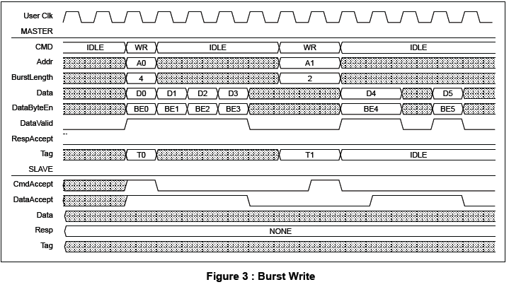
OCP Burst Write

Slide 15
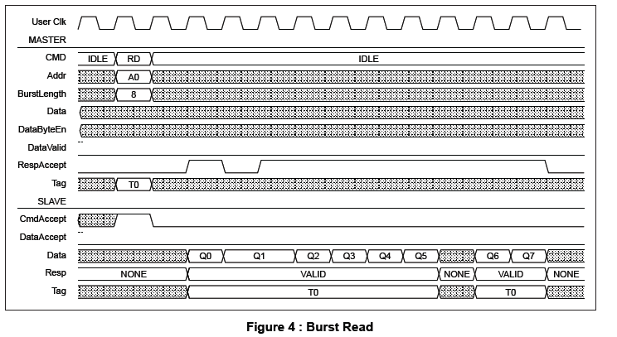
OCP Burst Read

Slide 16
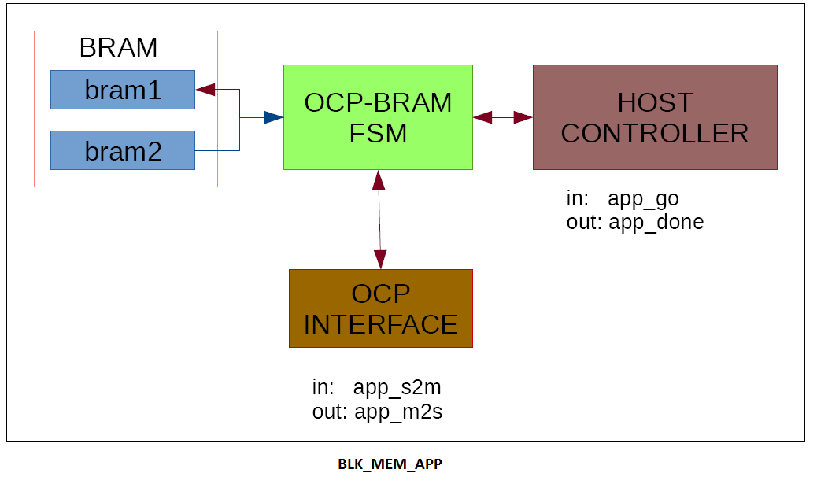
Top level block diagram of blk_mem_app

Slide 17
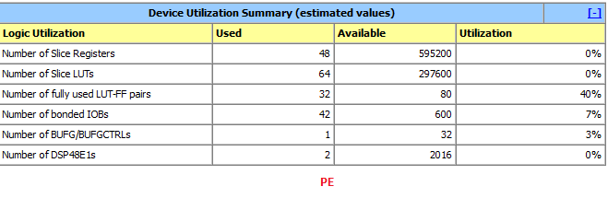
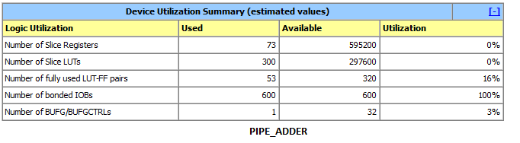
DEVICE UTILIZATION SUMMARY

Slide 18
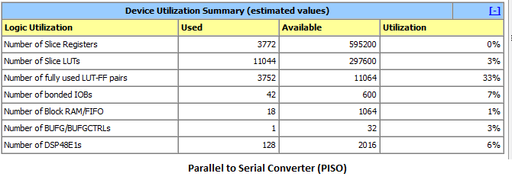
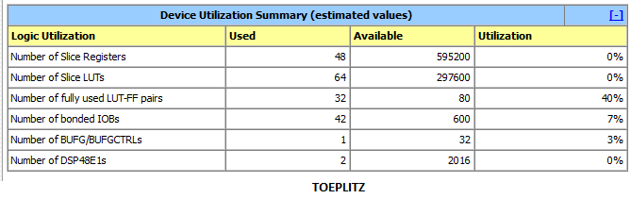
DEVICE UTILIZATION SUMMARY (Contd..)

Slide 19
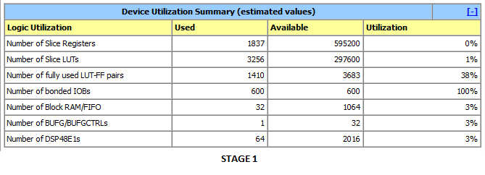
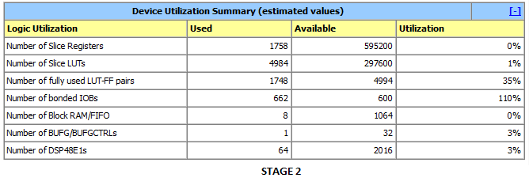
DEVICE UTILIZATION SUMMARY (Contd..)

Slide 20
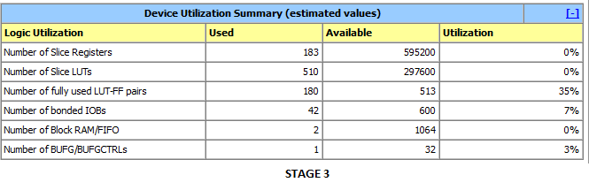
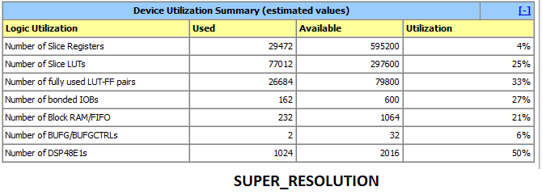
DEVICE UTILIZATION SUMMARY (Contd..)

